Slide 1
Convolutional Neural Network
2025/07/18
HUANG Jiahui, 44251017
Notes:
Today, I will present an introduction to Convolutional Neural Networks

Slide 2
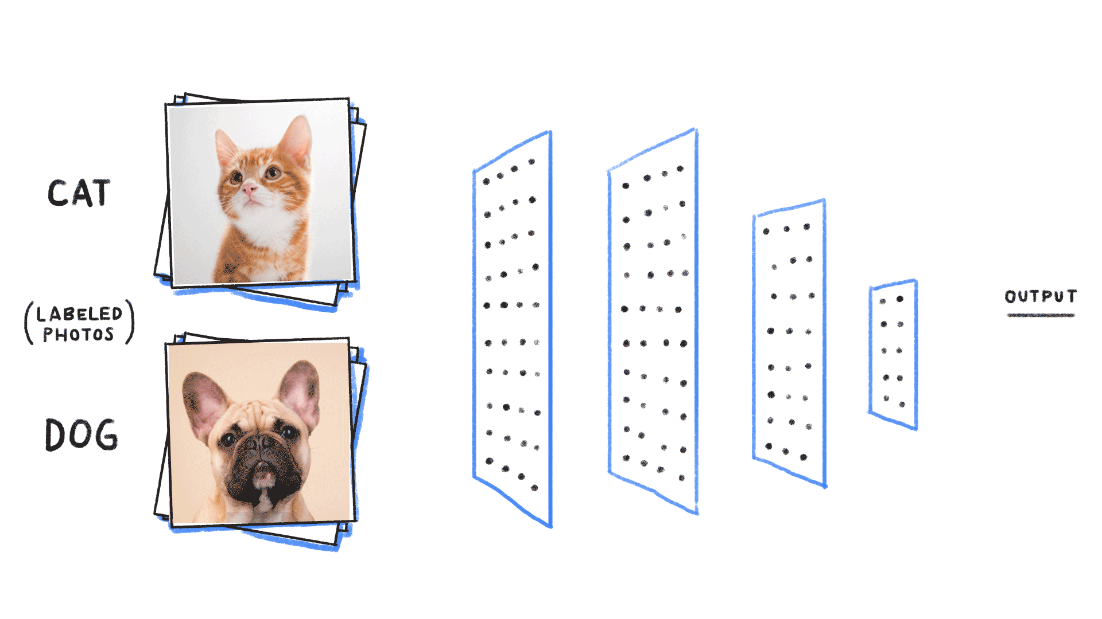
What Are Convolutional Neural Networks?
A convolutional neural network (CNN) is a type of feedforward neural network that learns features via filter (or kernel) optimization.
Convolutional neural networks use three-dimensional data for image classification and object recognition tasks.
Use convolution operations to extract local features.
Notes:
CNNs are a type of feedforward neural network that can learn features automatically through filter optimization.
They are especially effective at analyzing three-dimensional data, like RGB images. By performing convolution operations, CNNs are able to extract local features and patterns from input data.

Slide 3
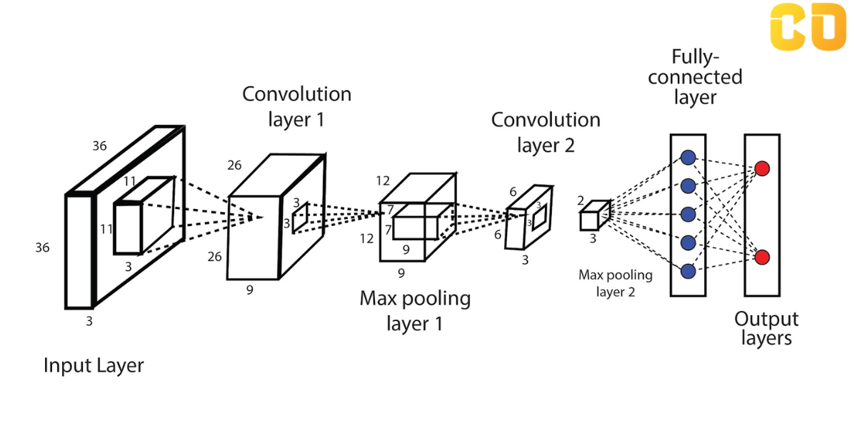
Key Layers in CNN
Convolutional neural networks are distinguished from other neural networks by their superior performance with image, speech or audio signal inputs. They have three main types of layers, which are:
Convolutional layer
Pooling layer
Fully-connected (FC) layer
Notes:
CNNs are composed of three key layers: convolutional layers, pooling layers, and fully connected layers.
Each layer plays a unique role in feature extraction, dimension reduction, and final classification.

Slide 4
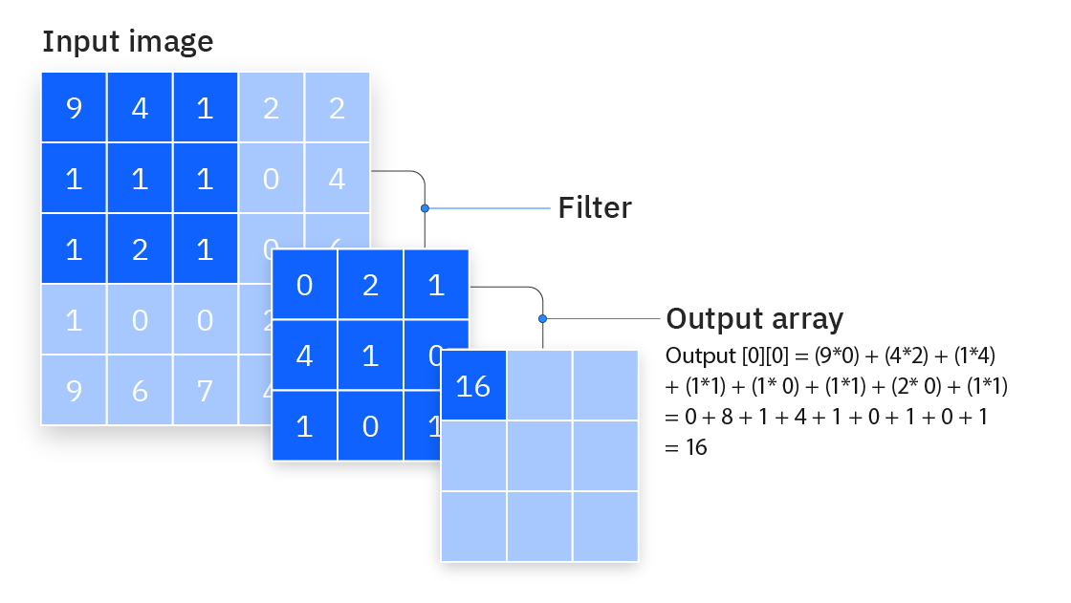
Convolutional Layer
The convolutional layer is the core building block of a CNN, and it is where the majority of computation occurs. It requires a few components, which are input data, a filter and a feature map.
Let’s assume that the input will be a color image, which is made up of a matrix of pixels in 3D. This means that the input will have three dimensions—a height, width and depth—which correspond to RGB in an image.
We also have a feature detector, also known as a kernel or a filter, which will move across the receptive fields of the image, checking if the feature is present. This process is known as a convolution.
After each convolution operation, a CNN applies a Rectified Linear Unit (ReLU) transformation to the feature map, introducing nonlinearity to the model.

Slide 5
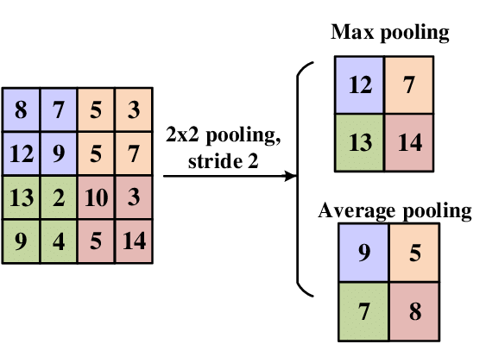
Pooling Layer
Pooling layers, also known as downsampling, conducts dimensionality reduction, reducing the number of parameters in the input.
Similar to the convolutional layer, the pooling operation sweeps a filter across the entire input, but the difference is that this filter does not have any weights. Instead, the kernel applies an aggregation function to the values within the receptive field, populating the output array.
There are two main types of pooling:
Max pooling
As the filter moves across the input, it selects the pixel with the maximum value to send to the output array.
Average pooling
As the filter moves across the input, it calculates the average value within the receptive field to send to the output array.

Slide 6
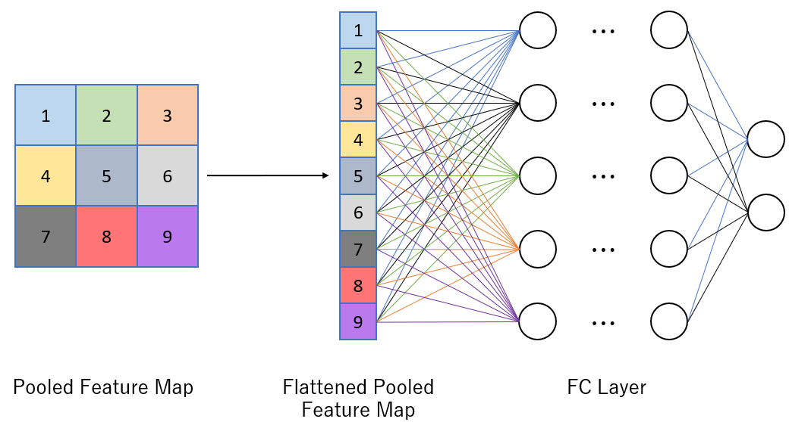
Fully-connected Layer
In the fully-connected layer, each node in the output layer connects directly to a node in the previous layer.
Fully-connected layer performs the task of classification based on the features extracted through the previous layers and their different filters.
While convolutional and pooling layers tend to use ReLu functions, FC layers usually leverage a softmax activation function to classify inputs appropriately, producing a probability from 0 to 1.
Notes:
The name of the full-connected layer aptly describes itself.
As mentioned earlier, the pixel values of the input image are not directly connected to the output layer in partially connected layers.
However, in the fully-connected layer, each node in the output layer connects directly to a node in the previous layer.
This layer performs the task of classification based on the features extracted through the previous layers and their different filters.
While convolutional and pooling layers tend to use ReLu functions, FC layers usually leverage a softmax activation function to classify inputs appropriately, producing a probability from 0 to 1.

Slide 7
Types of Convolutional Neural Networks
Kunihiko Fukushima and Yann LeCun laid the foundation of research around convolutional neural networks in their work in 1980
Yann LeCun continue his research with his team throughout the 1990s, culminating with “LeNet-5”, which applied the same principles of prior research to document recognition.
Since then, a number of variant CNN architectures have emerged with the introduction of new datasets, such as MNIST and CIFAR-10, and competitions, similar to ImageNet Large Scale Visual Recognition Challenge (ILSVRC). Some of these other architectures include:
AlexNet
VGGNet
GoogLeNet
ResNet
ZFNet
Notes:
To apply this method to large real-world problems, some improvements are needed. First, improving the quality of the lower bound is critical. A tighter bound means more pruning and faster search. Second, using best-first search and priority rules helps focus on the most promising branches. Third, we can parallelize the process and explore multiple branches at the same time. Finally, combining this method with metaheuristics like genetic algorithms or local search improves both speed and solution quality.
最后：These hybrid approaches allow the algorithm to quickly find high-quality solutions and then focus the exact branch-and-bound process on only the most promising subspaces.

Slide 8
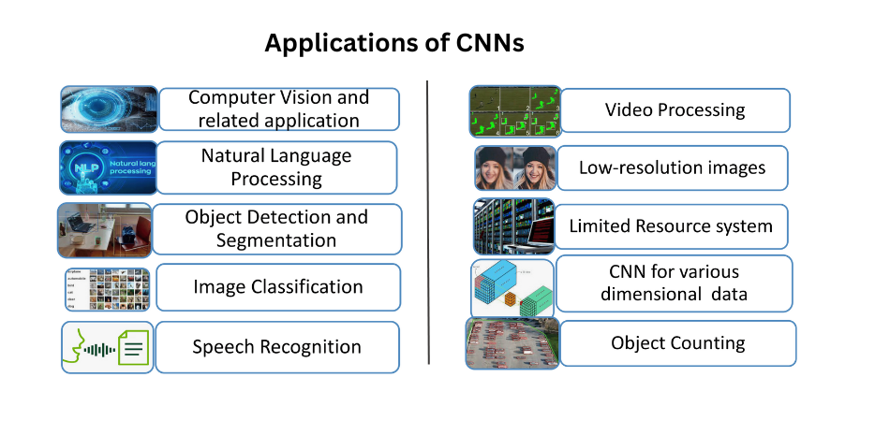
Applications of CNN
Notes:
CNNs are widely used in real-world tasks. Applications include image classification, object detection, medical image analysis, facial recognition, and autonomous driving systems.
Their ability to automatically extract features makes them ideal for visual data.

Slide 9
Thank You
Notes:
Thank you very much for listening.

